Slide 1
Assignments class 4

Slide 2
Exercise 1
 | Amount in mln ANG
Consumption | 50
Investment | 20
Government expenditures | 30
Exports | 20
Imports | 40
Calculate the net exports
Calculate the GDP

Slide 3
Exercise 2
 | Amount in mln ANG
GDP | 150
Consumption | 40
Investment | 20
Government expenditures | 60
Imports | 40
Calculate the exports
Calculate the net exports

Slide 4
Exercise 3
Stage of production | Seller | Buyer | Price
1 | Steel mill | Auto manufacturer | 10000
2 | Auto manufacturer | Auto dealer | 18000
3 | Auto dealer | Consumer | 25000
Calculate the value added of the auto manufacturer
Calculate the value added of the autodealer

Slide 5
Exercise 4
 | Amount in mln ANG
Employee compensation | 389
Corporate profits | 31
Dividend | 13
Rent | 13
Interest | 59
Calculate GDP using the income approach

Slide 6
Exercise 5
Calculate nominal GDP if the real GDP is US$2000 and the GDP deflator is 102.

Slide 7
Exercise 6
 | Amount in mln ANG
Nominal GDP | 520
Real GDP | 500
Calculate the GDP deflator

Slide 8
Exercise 7
 | Amount in mln ANG
Nominal GDP | 800
GDP deflator | 110
Calculate the real GDP

Slide 9
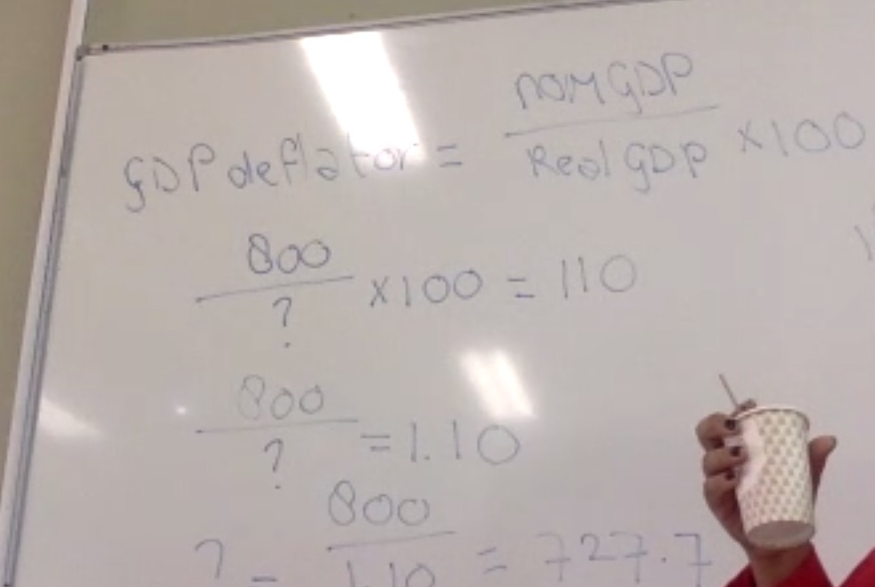

Slide 10
Exercise 8
Assume that the GDP of the United States is eight times as large as the GDP of China. Can you conclude, based on this information that the average individual in the US is eight times as well-off as the average individual in China?
Why or why not?

Slide 11
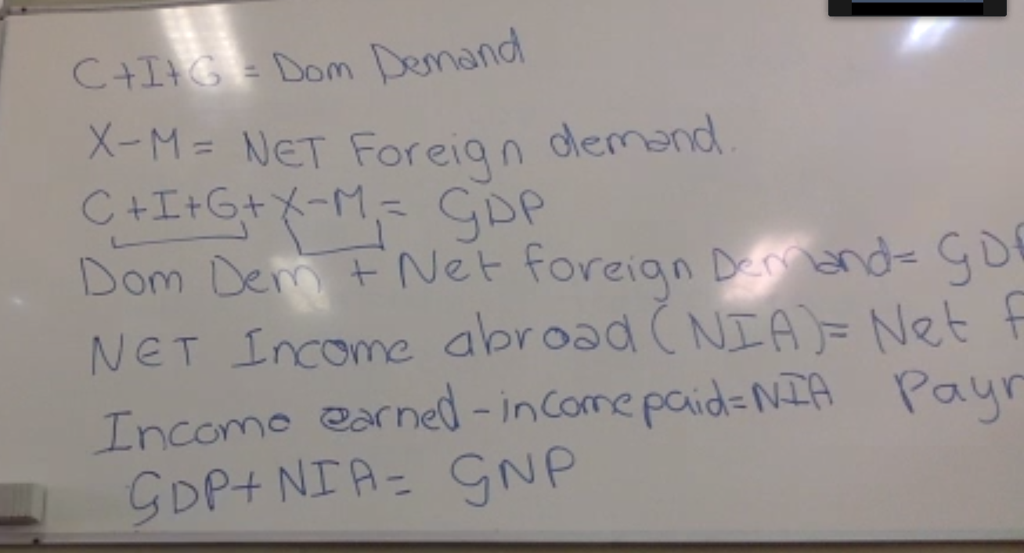

Slide 12
Exercise 9
 | Amount in mln ANG
Consumption | 100
Investment | 40
Government expenditures | 80
Exports | 40
Imports | 60
Income earned from abroad | 80
Income paid to abroad | 90
Calculate domestic demand
Calculate net foreign demand
Calculate GDP
Calculate NIA
Calculate GNP

Slide 13
Exercise 10
 | Amount in mln ANG
Consumption | 1000
Investment | 500
Government expenditures | 300
GDP | 1750
GNP | 1500
NNP | 1200
Calculate net foreign demand
Calculate NIA
Calculate Depreciation

Slide 14
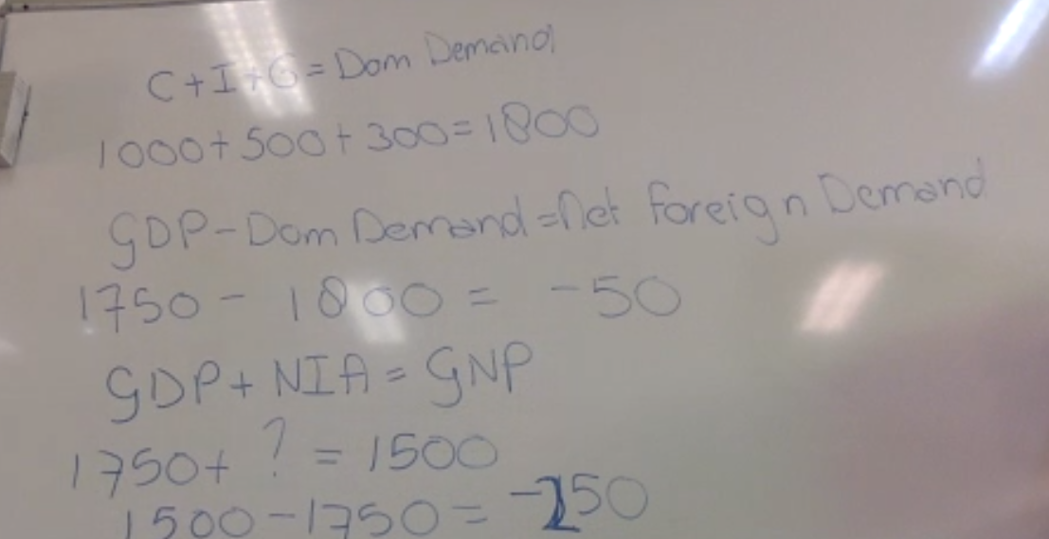

Slide 15
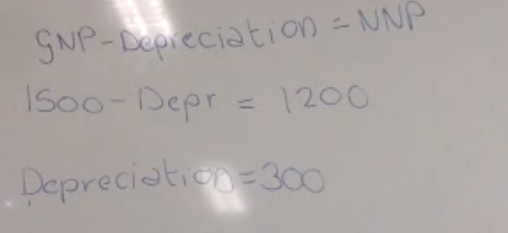
C

Slide 16
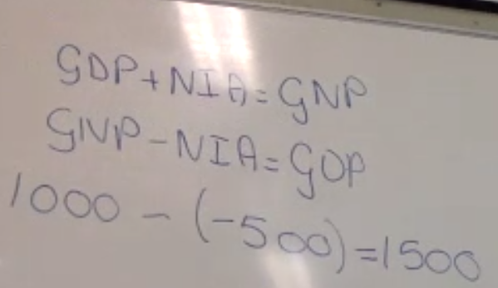
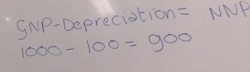
Exercise 11
 | Amount in mln ANG
GNP | 1000
NIA | -500
Depreciation | 100
Calculate GDP
Calculate NNP

Slide 17
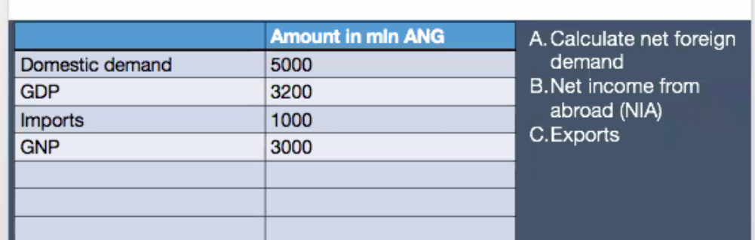

Slide 18
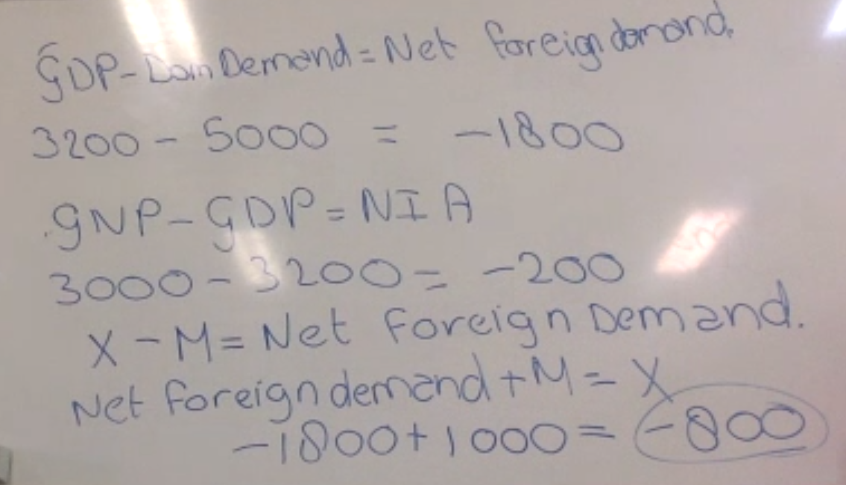

Slide 19
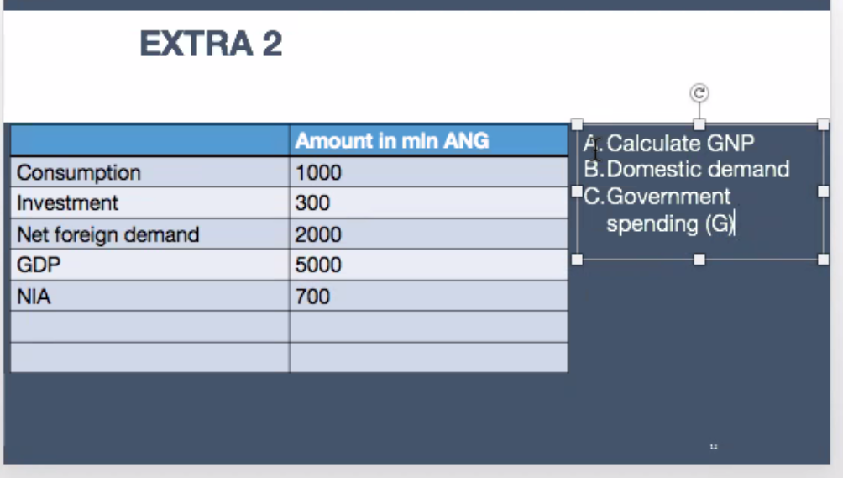

Slide 20
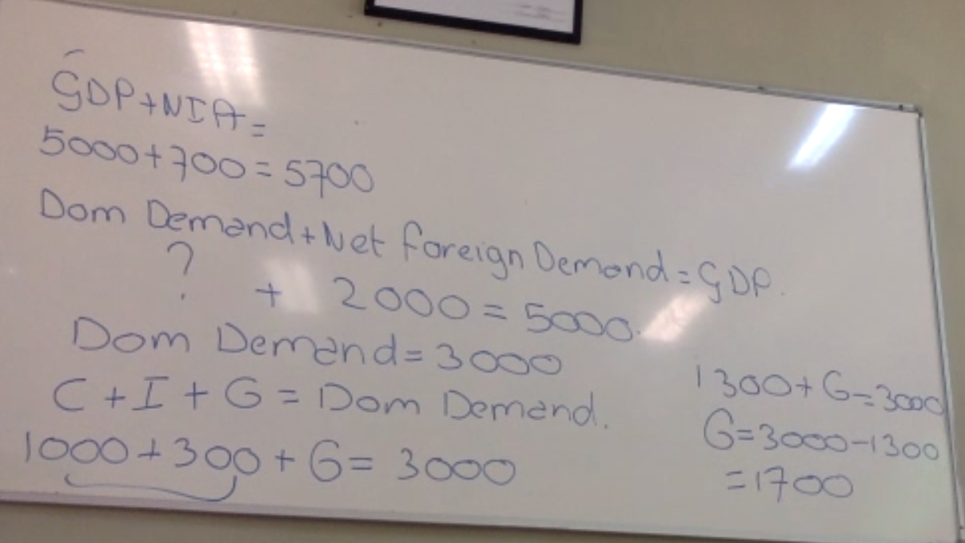

Slide 21
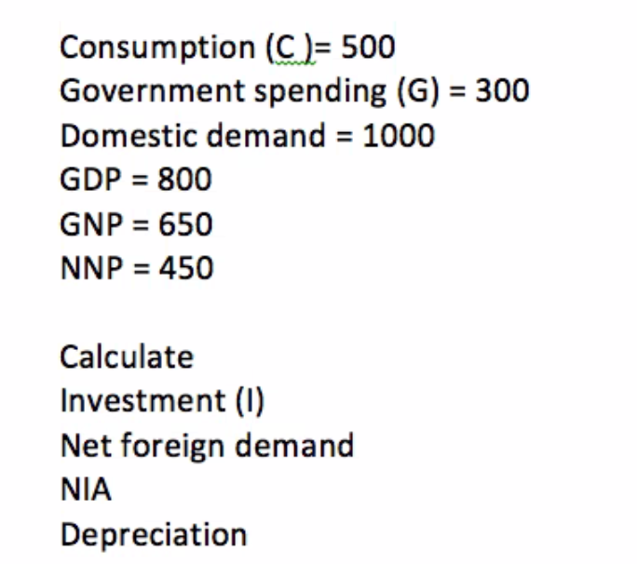
Extra

Slide 22
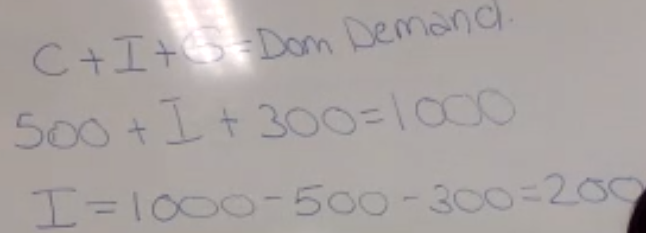
Extra Answer A

Slide 23
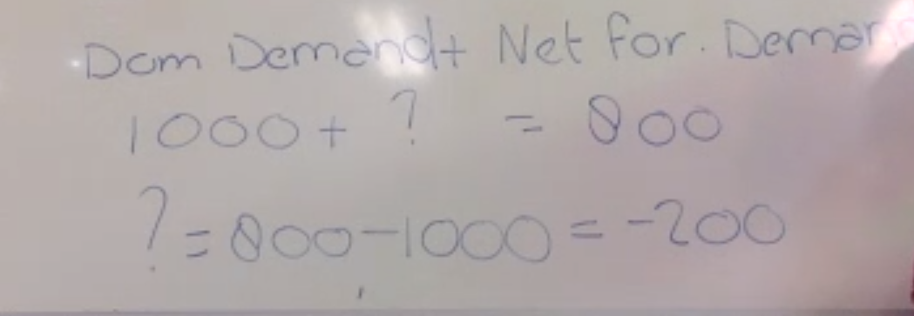
B Dom demand + netfor.demand = GDP

Slide 24
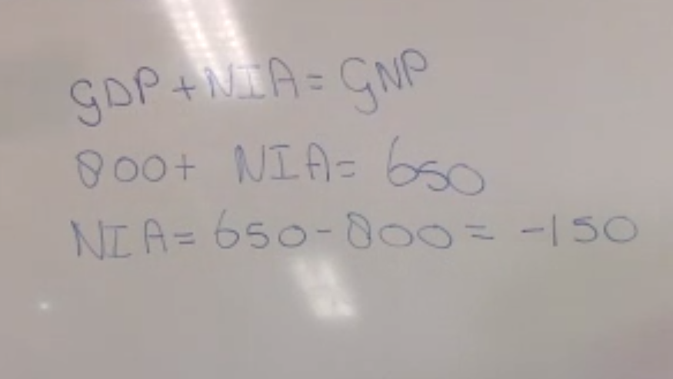
C

Slide 25
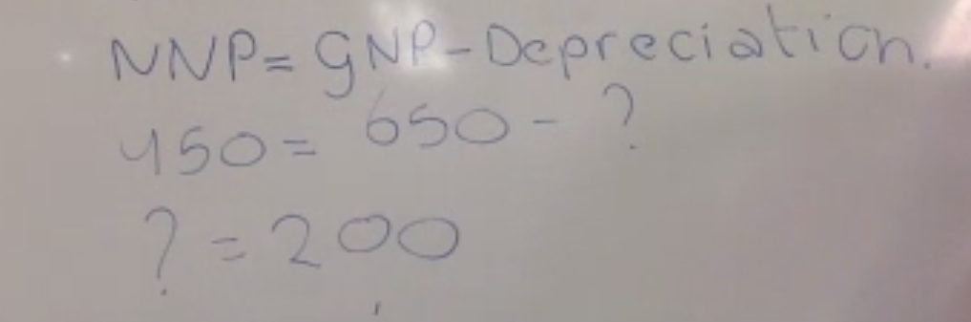
D

Slide 26
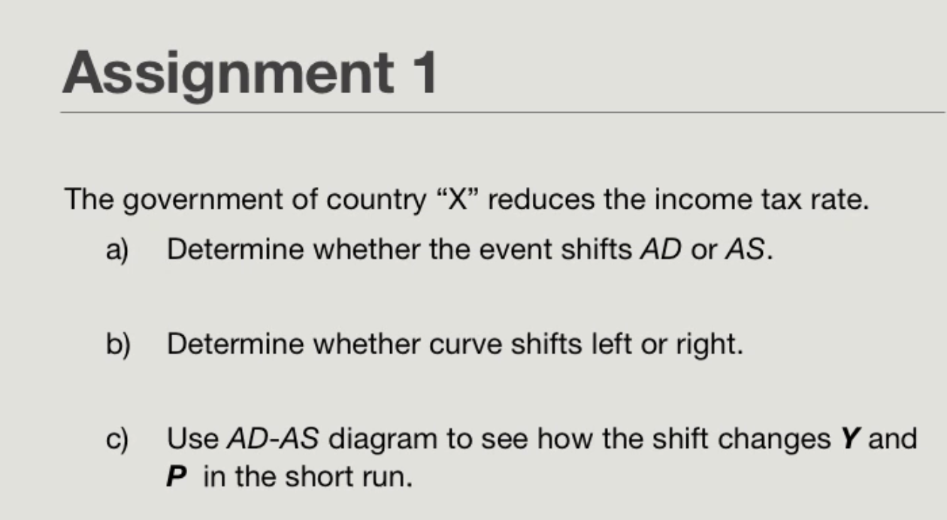

Slide 27
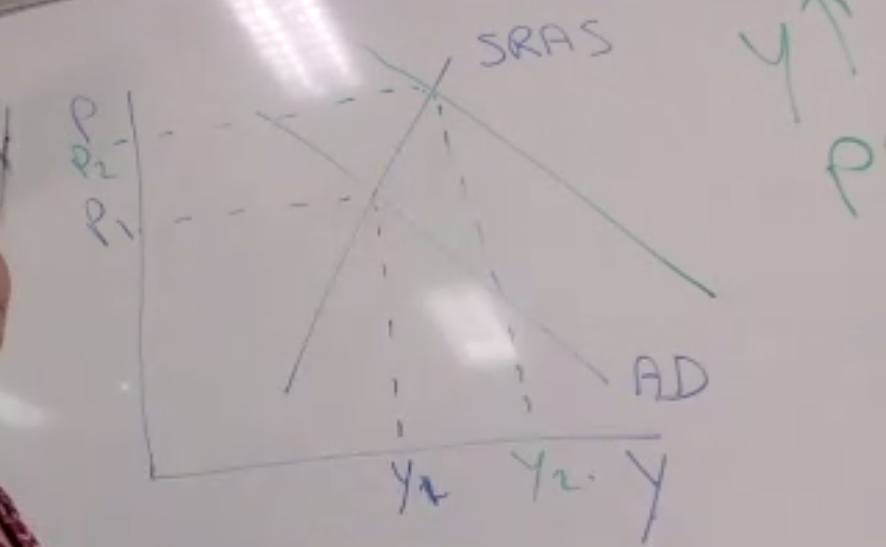

Slide 28
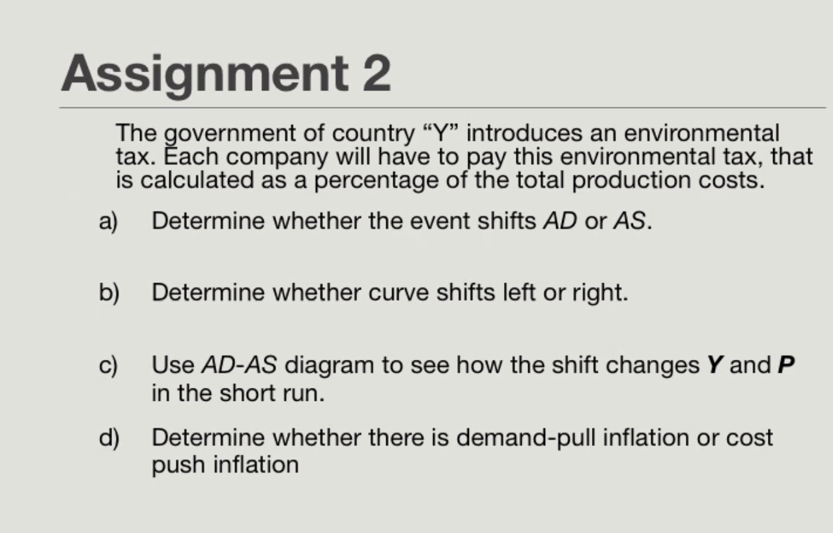

Slide 29
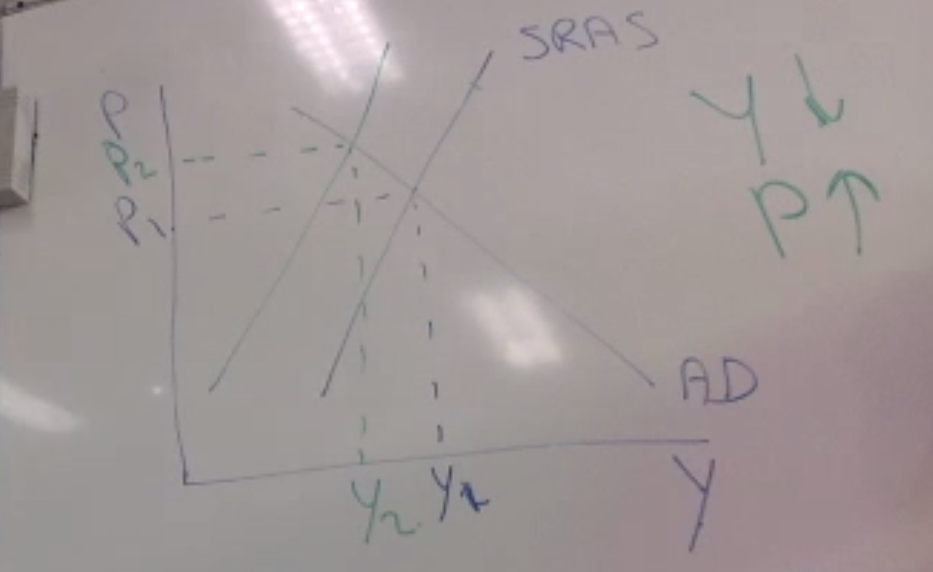

Slide 30
